Slide 1
[220] Dictionary Nesting
Meena Syamkumar
Mike Doescher
Cheaters caught: 0

Slide 2
Learning Objectives Today
More dictionary operations
len, in, for loop
d.keys(), d.values()
defaults for get and pop
Syntax for nesting (dicts inside dicts, etc)
indexing/lookup
step-by-step resolution
Understand common use cases for nesting
binning/bucketing (list in dict)
a more convenient table representation (dict in list)
transition probabilities with Markov chains (dict in dict)
list
dict
dict
dict
one of the most common
data analysis tasks
we’ll generate random
English-like texts

Slide 3
Today's Outline
Dictionary Ops
Binning (dict of list)
Table Representation (list of dict)
Probability Tables and Markov Chains (dict of dict)

Slide 4
Creation of Empty Dict
Non-empty dict:
d = {“a”: “alpha”, “b”: “beta”}
Empty dict (way 1):
d = {}
Empty dict (way 2):
d = dict()
similar for lists: L = list()
similar for sets: s = set()

Slide 5
len, in, for
num_words = {0:“zero”, 1:”one”, 2:”two”, 3:”three”}
print(len(num_words))
print(1 in num_words)
print(“one” in num_words)
for x in num_words:
print(x)
4

Slide 6
len, in, for
num_words = {0:“zero”, 1:”one”, 2:”two”, 3:”three”}
print(len(num_words))
print(1 in num_words)
print(“one” in num_words)
for x in num_words:
print(x)
4
?
?

Slide 7
len, in, for
num_words = {0:“zero”, 1:”one”, 2:”two”, 3:”three”}
print(len(num_words))
print(1 in num_words)
print(“one” in num_words)
for x in num_words:
print(x)
4
True
False (it is only checking keys, not vals)

Slide 8
len, in, for
num_words = {0:“zero”, 1:”one”, 2:”two”, 3:”three”}
print(len(num_words))
print(1 in num_words)
print(“one” in num_words)
for x in num_words:
print(x)
4
True
False (it is only checking keys, not vals)
?
?
?
?

Slide 9
len, in, for
num_words = {0:“zero”, 1:”one”, 2:”two”, 3:”three”}
print(len(num_words))
print(1 in num_words)
print(“one” in num_words)
for x in num_words:
print(x)
4
True
False (it is only checking keys, not vals)
0
1
2
3
(for iterates over keys, not vals)
(note there is no order here for
Python version < 3.7 )

Slide 10
len, in, for
num_words = {0:“zero”, 1:”one”, 2:”two”, 3:”three”}
print(len(num_words))
print(1 in num_words)
print(“one” in num_words)
for x in num_words:
print(x, num_words[x])
4
True
False (it is only checking keys, not vals)
0 zero
1 one
2 two
3 three
you can iterate over values
by combining a for loop with lookup

Slide 11
Extracting keys and values
num_words = {0:“zero”, 1:”one”, 2:”two”, 3:”three”}
print(type(num_words.keys()))
print(type(num_words.values()))
<class 'dict_keys'>
<class 'dict_values'>
don’t worry about these
new types, because we
can force them to be lists

Slide 12
Extracting keys and values
num_words = {0:“zero”, 1:”one”, 2:”two”, 3:”three”}
print(type(num_words.keys()))
print(type(num_words.values()))
print(list(num_words.keys()))
print(list(num_words.values()))
<class 'dict_keys'>
<class 'dict_values'>
[0, 1, 2, 3]
[ “zero”, “one”,
“two”, “three”]

Slide 13
Defaults with get and pop
suffix = {1:“st”, 2:”nd”, 3:”rd”}
suffix.pop(0) # delete fails, because no key 0
suffix[4] # lookup fails because no key 4

Slide 14
Defaults with get and pop
suffix = {1:“st”, 2:”nd”, 3:”rd”}
suffix.pop(0) # delete fails, because no key 0
suffix[4] # lookup fails because no key 4
suffix.get(4, “th”) # returns “th” because no key 4
specify a default if
key cannot be found

Slide 15
Defaults with get and pop
suffix = {1:“st”, 2:”nd”, 3:”rd”}
suffix.pop(0) # delete fails, because no key 0
suffix[4] # lookup fails because no key 4
suffix.get(4, “th”) # returns “th” because no key 4
specify a default if
key cannot be found
specify a default if
key cannot be found

Slide 16
Defaults with get and pop
suffix = {1:“st”, 2:”nd”, 3:”rd”}
suffix.pop(0, “th”) # returns “th” because no key 0
suffix[4] # lookup fails because no key 4
suffix.get(4, “th”) # returns “th” because no key 4
specify a default if
key cannot be found
specify a default if
key cannot be found

Slide 17
Defaults with get and pop
suffix = {1:“st”, 2:”nd”, 3:”rd”}
for num in range(6): print(str(num) + suffix.get(num, “th”))
0th
1st
2nd
3rd
4th
5th

Slide 18
Today's Outline
Dictionary Ops
Binning (dict of list)
Table Representation (list of dict)
Probability Tables and Markov Chains (dict of dict)

Slide 19
Bucketing/Binning
all
rows
2017
2018
2019

Slide 20
Bucketing/Binning
all
rows
for
loop
2017
2018
2019

Slide 21
Bucketing/Binning
all
rows
for
loop
2018 | 100mph | ...
2017
2018
2019

Slide 22
Bucketing/Binning
all
rows
for
loop
2018 | 100mph | ...
2017
2018
2019

Slide 23
Bucketing/Binning
all
rows
for
loop
2017
2018
2019

Slide 24
Bucketing/Binning
all
rows
for
loop
2019 | 95mph | ...
2017
2018
2019

Slide 25
Bucketing/Binning
all
rows
for
loop
2019 | 95mph | ...
2017
2018
2019

Slide 26
Bucketing/Binning
all
rows
for
loop
2019 | 95mph | ...
2017
2018
2019
list
list
list

Slide 27
Bucketing/Binning
all
rows
for
loop
dict
2019 | 95mph | ...
2017
2018
2019
list
list
list

Slide 28
Bins with lists and dicts
all data
rows = [
[2014, “A”, 123],
[2015, “B”, 120],
[2015, “C”, 140],
[2016, “D”, 100],
[2015, “E”, 130],
[2016, “F”, 200],
]

Slide 29
Bins with lists and dicts
all data
bins = {
2014: [
[2014, “A”, 123],
],
2015: [
[2015, “B”, 120],
[2015, “C”, 140],
[2015, “E”, 130],
],
2016: [
[2016, “D”, 100],
[2016, “F”, 200],
]
}
rows = [
[2014, “A”, 123],
[2015, “B”, 120],
[2015, “C”, 140],
[2016, “D”, 100],
[2015, “E”, 130],
[2016, “F”, 200],
]

Slide 30
Bins with lists and dicts
all data
bins = {
2014: [
[2014, “A”, 123],
],
2015: [
[2015, “B”, 120],
[2015, “C”, 140],
[2015, “E”, 130],
],
2016: [
[2016, “D”, 100],
[2016, “F”, 200],
]
}
median 123
rows = [
[2014, “A”, 123],
[2015, “B”, 120],
[2015, “C”, 140],
[2016, “D”, 100],
[2015, “E”, 130],
[2016, “F”, 200],
]
median 130
median 150

Slide 31
Demo 1: Median Tornado Speed per Year
Goal: print median speed of tornados for each year
Input:
Tornado CSV
Output:
Median within each year
Example: prompt> python tornados.py … 2015: 130 2016: 123 2017: 90

Slide 32
Today's Outline
Dictionary Ops
Binning (dict of list)
Table Representation (list of dict)
Probability Tables and Markov Chains (dict of dict)

Slide 33
Table Representation
name | x | y
Alice | 30 | 20
Bob | 5 | 11
Cindy | -2 | 50
list of list representation
list of dict representation
header = [“name”, “x”, “y”]
rows = [
[“Alice”, 30, 20],
[“Bob”, 5, 11],
[“Cindy”, -2, 50],
]
[
{“name”:“Alice”, “x”:30, “y”:20”},
{“name”:“Bob”, “x”:5, “y”:11”},
{“name”:“Cindy”, “x”:-2, “y”:50”},
]

Slide 34
Table Representation
name | x | y
Alice | 30 | 20
Bob | 5 | 11
Cindy | -2 | 50
list of list representation
list of dict representation
header = [“name”, “x”, “y”]
rows = [
[“Alice”, 30, 20],
[“Bob”, 5, 11],
[“Cindy”, -2, 50],
]
[
{“name”:“Alice”, “x”:30, “y”:20”},
{“name”:“Bob”, “x”:5, “y”:11”},
{“name”:“Cindy”, “x”:-2, “y”:50”},
]
2
2
"y"
2
rows[2][header.index(“y”)]
rows[2][“y”]

Slide 35
Demo 2: Table Transform
Goal: create function that transforms list of lists table to a list of dicts table
Input:
List of lists (from a CSV)
Output:
List of dicts
Example: >>> header = [“x”,”y”] >>> rows = [[1,2], [3,4]] >>> transform(header, rows) [{“x”:1, “y”:2}, {“x”:3, “y”:4}]

Slide 36
Today's Outline
Dictionary Ops
Binning (dict of list)
Table Representation (list of dict)
Probability Tables and Markov Chains (dict of dict)

Slide 37
Demo 3: Letter Frequency
53‡‡†305))6*;4826)4‡.)4‡);806*;48†8
¶60))85;;]8*;:‡*8†83(88)5*†;46(;88*96
*?;8)*‡(;485);5*†2:*‡(;4956*2(5*—4)8
¶8*;4069285);)6†8)4‡‡;1(‡9;48081;8:8‡
1;48†85;4)485†528806*81(‡9;48;(88;4
(‡?34;48)4‡;161;:188;‡?;
can you guess what 8 represents?

Slide 38
Demo 3: Letter Frequency
53‡‡†305))6*;4826)4‡.)4‡);806*;48†8
¶60))85;;]8*;:‡*8†83(88)5*†;46(;88*96
*?;8)*‡(;485);5*†2:*‡(;4956*2(5*—4)8
¶8*;4069285);)6†8)4‡‡;1(‡9;48081;8:8‡
1;48†85;4)485†528806*81(‡9;48;(88;4
(‡?34;48)4‡;161;:188;‡?;
can you guess what 8 represents?
https://en.wikipedia.org/wiki/The_Gold-Bug

Slide 39
Demo 3: Letter Frequency
letters
symbols
how to compute these?
https://en.wikipedia.org/wiki/The_Gold-Bug

Slide 40
Demo 3: Letter Frequency
Goal: if we randomly pick a word in a text, what is the probability that it will be a given letter?
Input:
Plaintext of book (from Project Gutenberg)
Output:
The portion of letters in the text that are that letter
Example: text: AAAAABBCCC A: 50% B: 20% C: 30%
https://en.wikipedia.org/wiki/The_Gold-Bug

Slide 41
Sequence Data
Consider this sequence: “the quick tiger is quiet”
What letter likely comes after “t” in this text?

Slide 42
Sequence Data
Consider this sequence: “the quick tiger is quiet”
What letter likely comes after “t” in this text?
Next Letter | Probability
h | 50%
i | 50%
a | 0%
… | 0%
dict for “t”:
{“h”: 0.5, “i”: 0.5}

Slide 43
Sequence Data
Consider this sequence: “the quick tiger is quiet”
What letter likely comes after “t” in this text?
What letter likely comes after “q” in this text?
Next Letter | Probability
h | 50%
i | 50%
a | 0%
… | 0%
dict for “t”:
{“h”: 0.5, “i”: 0.5}
Next Letter | Probability
u | 100%
… | 0%
dict for “q”:
{“u”: 1.0}

Slide 44
Sequence Data
Imagine a next-letter probability
dictionary for every letter
Consider this sequence: “the quick tiger is quiet”
What letter likely comes after “t” in this text?
What letter likely comes after “q” in this text?
Next Letter | Probability
h | 50%
i | 50%
a | 0%
… | 0%
dict for “t”:
{“h”: 0.5, “i”: 0.5}
Next Letter | Probability
u | 100%
… | 0%
dict for “q”:
{“u”: 1.0}

Slide 45
Sequence Data
Imagine a next-letter probability
dictionary for every letter
Consider this sequence: “the quick tiger is quiet”
What letter likely comes after “t” in this text?
What letter likely comes after “q” in this text?
dict for “u”:
{“i”: 1.0}
Next Letter | Probability
h | 50%
i | 50%
a | 0%
… | 0%
dict for “t”:
{“h”: 0.5, “i”: 0.5}
dict for “i”:
{“c”: 0.25, “g”: 0.25, “s”: 0.25, “e”: 0.25}
Next Letter | Probability
u | 100%
… | 0%
dict for “q”:
{“u”: 1.0}
…

Slide 46
Sequence Data
Organize all the dicts with a dict:
Imagine a next-letter probability
dictionary for every letter
probs = {
“u”:
}
dict for “u”:
{“i”: 1.0}
dict for “t”:
{“h”: 0.5, “i”: 0.5}
dict for “i”:
{“c”: 0.25, “g”: 0.25, “s”: 0.25, “e”: 0.25}
dict for “q”:
{“u”: 1.0}
…

Slide 47
Sequence Data
Organize all the dicts with a dict:
Imagine a next-letter probability
dictionary for every letter
probs = {
“u”: {“i”: 1.0},
}
dict for “u”:
{“i”: 1.0}
dict for “t”:
{“h”: 0.5, “i”: 0.5}
dict for “i”:
{“c”: 0.25, “g”: 0.25, “s”: 0.25, “e”: 0.25}
dict for “q”:
{“u”: 1.0}
…

Slide 48
Sequence Data
Organize all the dicts with a dict:
Imagine a next-letter probability
dictionary for every letter
probs = {
“u”: {“i”: 1.0},
“t”: {“h”: 0.5, “i”: 0.5}
“i”: {“c”: 0.25, “g”: 0.25, “s”: 0.25, “e”: 0.25},
“q”: {“u”: 1.0},
…
}
dict for “u”:
{“i”: 1.0}
dict for “t”:
{“h”: 0.5, “i”: 0.5}
dict for “i”:
{“c”: 0.25, “g”: 0.25, “s”: 0.25, “e”: 0.25}
dict for “q”:
{“u”: 1.0}
…

Slide 49
Sequence Data
Organize all the dicts with a dict:
Imagine a next-letter probability
dictionary for every letter
probs = {
“u”: {“i”: 1.0},
“t”: {“h”: 0.5, “i”: 0.5}
“i”: {“c”: 0.25, “g”: 0.25, “s”: 0.25, “e”: 0.25},
“q”: {“u”: 1.0},
…
}
dict for “u”:
{“i”: 1.0}
dict for “t”:
{“h”: 0.5, “i”: 0.5}
dict for “i”:
{“c”: 0.25, “g”: 0.25, “s”: 0.25, “e”: 0.25}
probs[“i”]
dict for “q”:
{“u”: 1.0}
…

Slide 50
Sequence Data
Organize all the dicts with a dict:
Imagine a next-letter probability
dictionary for every letter
probs = {
“u”: {“i”: 1.0},
“t”: {“h”: 0.5, “i”: 0.5}
“i”: {“c”: 0.25, “g”: 0.25, “s”: 0.25, “e”: 0.25},
“q”: {“u”: 1.0},
…
}
dict for “u”:
{“i”: 1.0}
dict for “t”:
{“h”: 0.5, “i”: 0.5}
dict for “i”:
{“c”: 0.25, “g”: 0.25, “s”: 0.25, “e”: 0.25}
probs[“i”][“e”] 0.25
There is a 25% probability that the letter following an “i” is an “e”
dict for “q”:
{“u”: 1.0}
…

Slide 51
Vocabulary
probs = {
“u”: {“i”: 1.0},
“t”: {“h”: 0.5, “i”: 0.5}
“i”: {“c”: 0.25, “g”: 0.25, “s”: 0.25, “e”: 0.25},
“q”: {“u”: 1.0},
…
}
The collection of transition probabilities like this is sometimes called a “stochastic matrix”
Processes that make probabilistic transitions
like this (e.g., from one letter to the next) are
called “Markov chains”

Slide 52
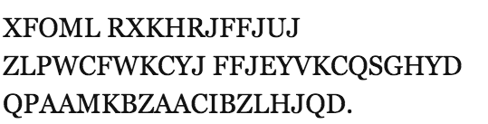
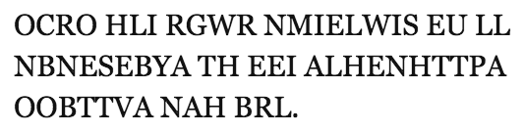
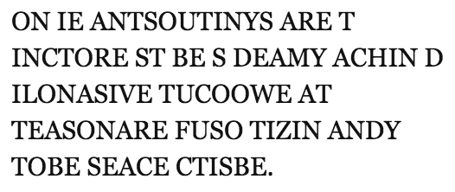
Random Text Generation
1
which looks
closest to
English?
2
3
Examples from A Mind at Play, by Soni and Goodman

Slide 53
Random Text Generation
all letters equally likely
weighted random, based
on frequency in a text
(implement with dict)
probability of each letter
based on previous letter
(implement with dict of dicts)
Examples from A Mind at Play, by Soni and Goodman

Slide 54
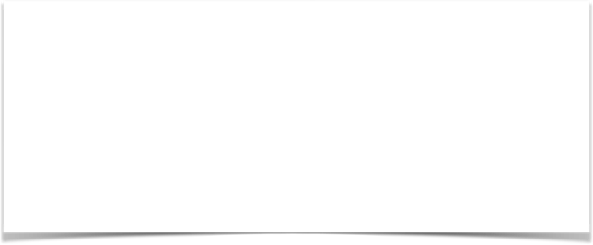
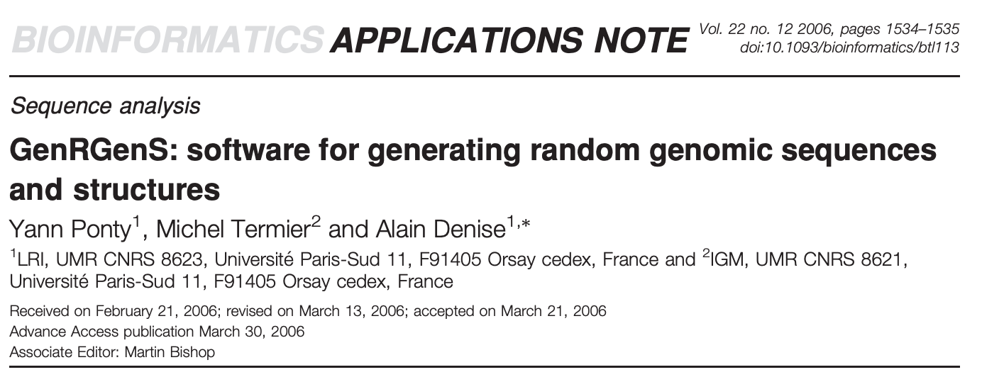
Hypothetical Use Case
DNA sequences
GATACAGATACAGATACA
stochastic model
GCTATAGCTATAGCGCGC
AAAATTTTAAAATTTTAAAA
CATCATC?TC?TCATC?TCAT
CATCATCATCATCATCATCAT
synthetic sequences,
filling in gaps

Slide 55
Demo 4: Conditional Letter Frequency
Goal: if we look at given letter, what is the next letter likely to be?
Input:
Plaintext of book (from Project Gutenberg)
Output:
Transition probabilities
Randomly generated text, based on probabilities

Slide 56
Weighted Random
transitions = { “up”: 0.2, “down”: 0.1, “flat”: 0.7 }

Slide 57
Weighted Random
transitions = { “up”: 0.2, “down”: 0.1, “flat”: 0.7 }
up
flat
down
0
0.2
0.4
0.6
0.8
1
probabilities

Slide 58
Weighted Random
transitions = { “up”: 0.2, “down”: 0.1, “flat”: 0.7 }
x = random.random()
up
flat
down
0
0.2
0.4
0.6
0.8
1
probabilities

Slide 59
Weighted Random
transitions = { “up”: 0.2, “down”: 0.1, “flat”: 0.7 }
x = random.random() # assume 0.5
up
flat
down
0
0.2
0.4
0.6
0.8
1
probabilities

Slide 60
Weighted Random
transitions = { “up”: 0.2, “down”: 0.1, “flat”: 0.7 }
x = random.random() # assume 0.5
flat “wins”
up
flat
down
0
0.2
0.4
0.6
0.8
1
probabilities

Slide 61
Weighted Random
transitions = { “up”: 0.2, “down”: 0.1, “flat”: 0.7 }
x = random.random() # assume 0.25
up
flat
down
0
0.2
0.4
0.6
0.8
1
probabilities

Slide 62
Weighted Random
transitions = { “up”: 0.2, “down”: 0.1, “flat”: 0.7 }
x = random.random() # assume 0.25
up
flat
down
0
0.2
0.4
0.6
0.8
1
probabilities

Slide 63
Weighted Random
transitions = { “up”: 0.2, “down”: 0.1, “flat”: 0.7 }
x = random.random() # assume 0.25
down “wins”
up
flat
down
0
0.2
0.4
0.6
0.8
1
probabilities

Slide 64
Weighted Random
x
transitions = { “up”: 0.2, “down”: 0.1, “flat”: 0.7 }
x = random.random() # assume 0.25
end = 0 keys = [“up”, “down”, “flat”] winner = None for key in keys: end += transitions[key] if end >= x: winner = key break
up
flat
down
0
0.2
0.4
0.6
0.8
1
probabilities

Slide 65
Weighted Random
end
x
transitions = { “up”: 0.2, “down”: 0.1, “flat”: 0.7 }
x = random.random() # assume 0.25
end = 0 keys = [“up”, “down”, “flat”] winner = None for key in keys: end += transitions[key] if end >= x: winner = key break
up
flat
down
0
0.2
0.4
0.6
0.8
1
probabilities
key
up
end
0

Slide 66
Weighted Random
end
x
transitions = { “up”: 0.2, “down”: 0.1, “flat”: 0.7 }
x = random.random() # assume 0.25
end = 0 keys = [“up”, “down”, “flat”] winner = None for key in keys: end += transitions[key] if end >= x: winner = key break
up
flat
down
0
0.2
0.4
0.6
0.8
1
probabilities
key
up
end
0.2

Slide 67
Weighted Random
end
x
transitions = { “up”: 0.2, “down”: 0.1, “flat”: 0.7 }
x = random.random() # assume 0.25
end = 0 keys = [“up”, “down”, “flat”] winner = None for key in keys: end += transitions[key] if end >= x: winner = key break
up
flat
down
0
0.2
0.4
0.6
0.8
1
probabilities
key
up
end
0.2

Slide 68
Weighted Random
end
x
transitions = { “up”: 0.2, “down”: 0.1, “flat”: 0.7 }
x = random.random() # assume 0.25
end = 0 keys = [“up”, “down”, “flat”] winner = None for key in keys: end += transitions[key] if end >= x: winner = key break
up
flat
down
0
0.2
0.4
0.6
0.8
1
probabilities
key
down
end
0.2

Slide 69
Weighted Random
end
x
transitions = { “up”: 0.2, “down”: 0.1, “flat”: 0.7 }
x = random.random() # assume 0.25
end = 0 keys = [“up”, “down”, “flat”] winner = None for key in keys: end += transitions[key] if end >= x: winner = key break
up
flat
down
0
0.2
0.4
0.6
0.8
1
probabilities
key
down
end
0.3

Slide 70
Weighted Random
end
x
transitions = { “up”: 0.2, “down”: 0.1, “flat”: 0.7 }
x = random.random() # assume 0.25
end = 0 keys = [“up”, “down”, “flat”] winner = None for key in keys: end += transitions[key] if end >= x: winner = key break
up
flat
down
0
0.2
0.4
0.6
0.8
1
probabilities
key
down
end
0.3
we randomly chose “down”

